Slide 1
Learning Objective
I will be able to apply exponential functions in modelling growth and decay
Success Criteria
At the end of the lesson, I will be able to:
Apply exponential functions in modelling growth and decay

Slide 2
Compound Interest
VOCABULARY
Principal – the original amount of money borrowed or invested Interest – the additional amount paid or earned Compound interest – interest gets added onto the principal
Typical example of a growth/decay model: Compound Interest
Compound interest: The interest calculated on to the principal and accumulated interest from previous period.
To calculate compound interest:
Calculate the interest on the principal at the end of the first period.
Add the interest to the principal to make the new principal for the second period.
Calculate the interest on the new principal at the end of the second period.
Add the interest to the principal to make the new principal for the third period.
Etc. etc.

Slide 3
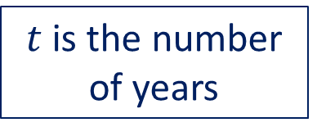
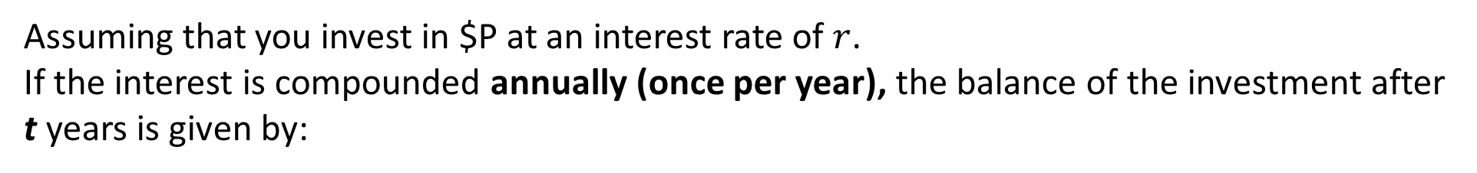
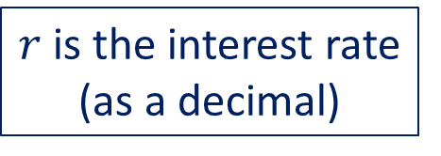
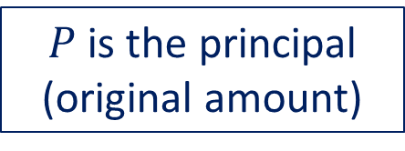
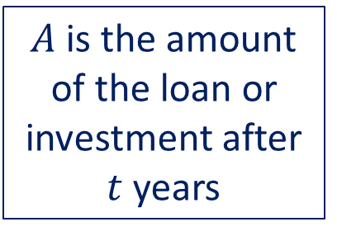

Compound Interest
Assuming that you invest in $P at an interest rate of $r$.
If the interest is compounded annually (once per year), the balance of the investment after t years is given by:
$$A={P (1+r) }^{t}$$
$A$is the amount of the loan or investment after $t$ years
$t$ is the number of years
$P$ is the principal (original amount)
$r$is the interest rate (as a decimal)

Slide 4
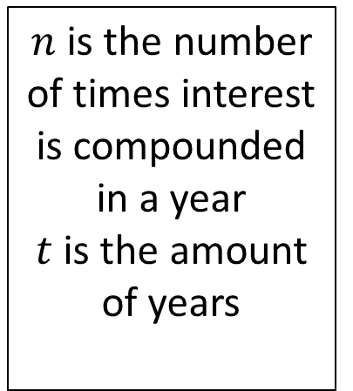

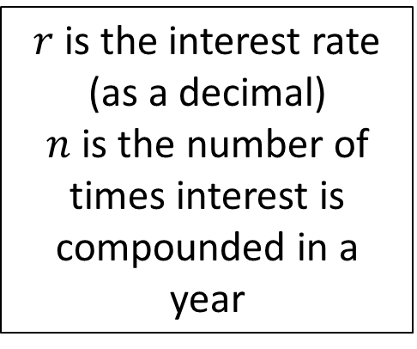
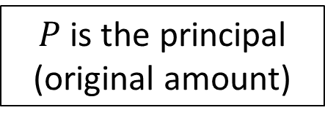
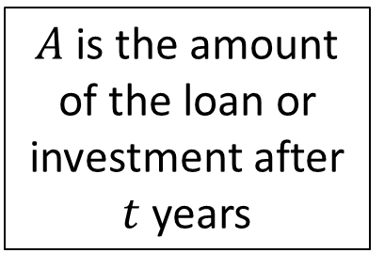
Compound Interest
If we expand and look at interest being compounded n times per year.
The interest rate is now $\frac{r}{n}$. The balance at the end of t years is given by:
$$A={P (1+\frac{r}{n}) }^{nt}$$
$n$ is the number of times interest is compounded in a year
$t$ is the amount of years
$A$is the amount of the loan or investment after $t$ years
$P$ is the principal (original amount)
$r$is the interest rate (as a decimal)
$n$ is the number of times interest is compounded in a year

Slide 5
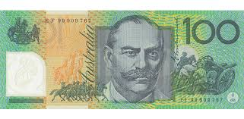
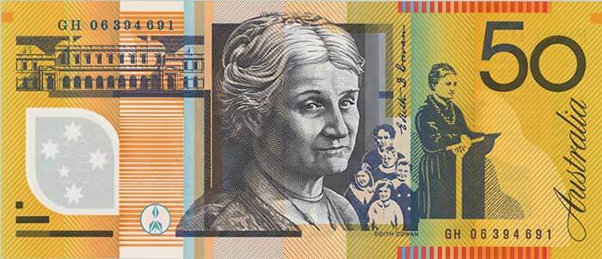
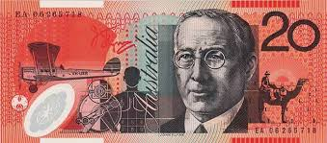
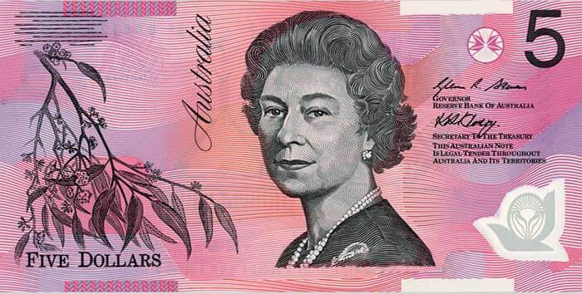
Compound Interest
Consider the following situation: you borrow $100 for one year charged with
100% interest per annum, and then at the end of the year the bank collects
what you owe. How much would you owe if after 1 year, the interest had been
compounded half yearly?
+
FIRST 6 MONTHS
PRINCIPAL
50% OF THE PRINCIPAL
+
SECOND 6 MONTHS
The total amount
owed to the bank is
$225
NEW PRINCIPAL
50% OF THE PRINCIPAL

Slide 6
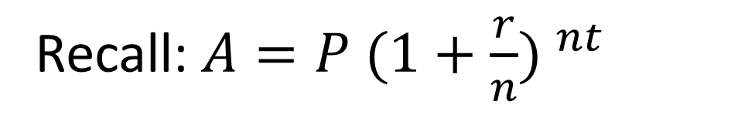
Compound Interest
Now consider the same situation for the following compounding periods:
Every 3 months
Monthly
Weekly
Daily
Hourly
Every minute
Recall: $A={P (1+\frac{r}{n}) }^{nt}$

Slide 7
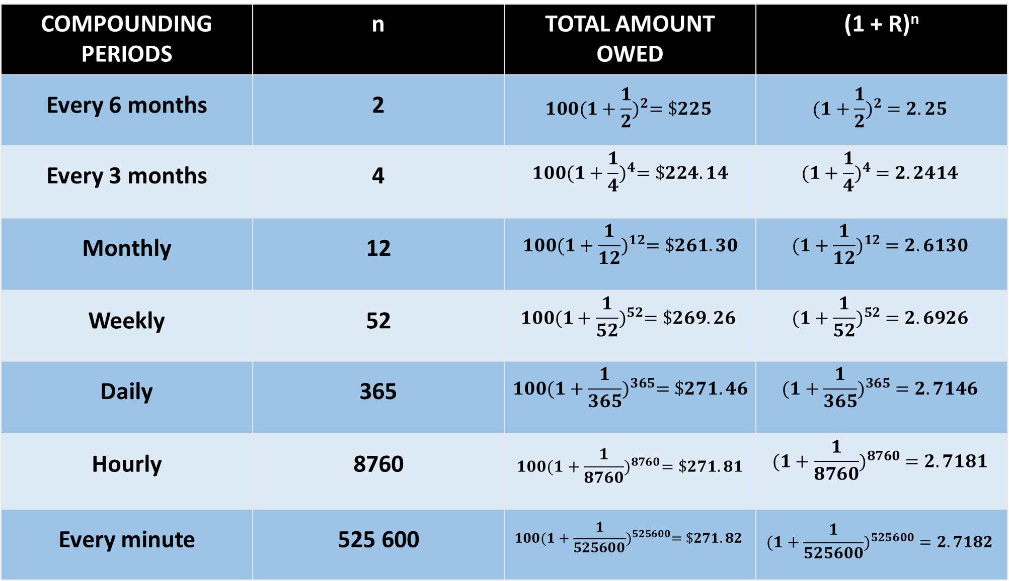
COMPOUNDING PERIODS | n | TOTAL AMOUNT OWED | (1 + R)^{n}
Every 6 months | 2 | $$100{(1+\frac{1}{2})}^{2}=\$225$$ | $${(1+\frac{1}{2})}^{2} =2.25$$
Every 3 months | 4 | $$100{(1+\frac{1}{4})}^{4}=\$224.14$$ | $${(1+\frac{1}{4})}^{4} =2.2414$$
Monthly | 12 | $$100{(1+\frac{1}{12})}^{12}=\$261.30$$ | $${(1+\frac{1}{12})}^{12} =2.6130$$
Weekly | 52 | $$100{(1+\frac{1}{52})}^{52}=\$269.26$$ | $${(1+\frac{1}{52})}^{52} =2.6926$$
Daily | 365 | $$100{(1+\frac{1}{365})}^{365}=\$271.46$$ | $${(1+\frac{1}{365})}^{365} =2.7146$$
Hourly | 8760 | $$100{(1+\frac{1}{8760})}^{8760}=\$271.81$$ | $${(1+\frac{1}{8760})}^{8760} =2.7181$$
Every minute | 525 600 | $$100{(1+\frac{1}{525600})}^{525600}=\$271.82$$ | $${(1+\frac{1}{525600})}^{525600} =2.7182$$

Slide 8
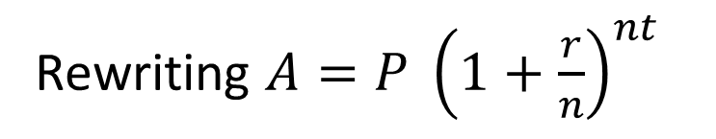
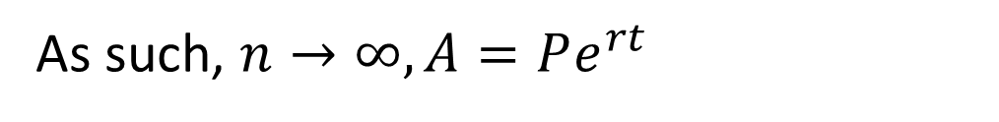
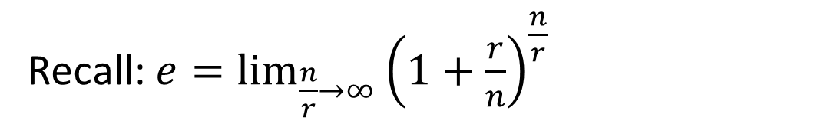

Compound Interest
Rewriting $A={P \left(1+\frac{r}{n}\right)}^{nt}$
$$A=P{\left({\left(1+\frac{r}{n}\right)}^{\frac{n}{r}}\right)}^{rt}$$
Recall: $e=\lim_{\frac{n}{r}→∞}{{\left(1+\frac{r}{n}\right)}^{\frac{n}{r}}}$
As such, $n→∞, A=Pe^{rt}$
We can now say that continues compounding will result in a continuous growth situation that is geometric.

Slide 9
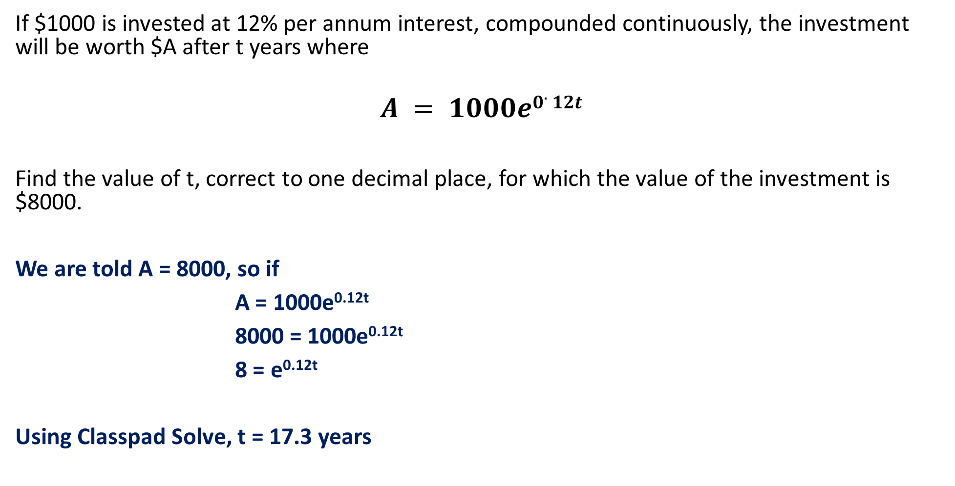
Guided Practice
If $1000 is invested at 12% per annum interest, compounded continuously, the investment will be worth $A after t years where
$$A = 1000e0.12t$$
Find the value of t, correct to one decimal place, for which the value of the investment is $8000.
We are told A = 8000, so if
A = 1000e^{0.12t}
8000 = 1000e^{0.12t}
8 = e^{0.12t}
Using Classpad Solve, t = 17.3 years

Slide 10
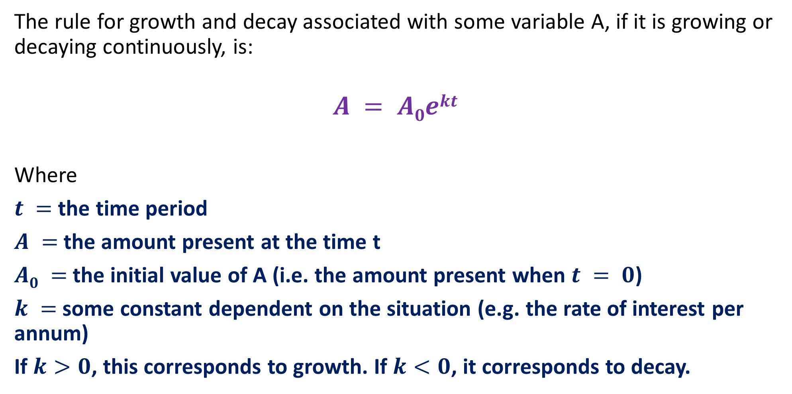
Growth and Decay
The rule for growth and decay associated with some variable A, if it is growing or decaying continuously, is:
$$A = A0ekt$$
Where
$t =$ the time period
$A =$the amount present at the time t
$A0 =$the initial value of A (i.e. the amount present when $t = 0$)
$k =$some constant dependent on the situation (e.g. the rate of interest per annum)
If $k>0$, this corresponds to growth. If $k<0$, it corresponds to decay.

Slide 11
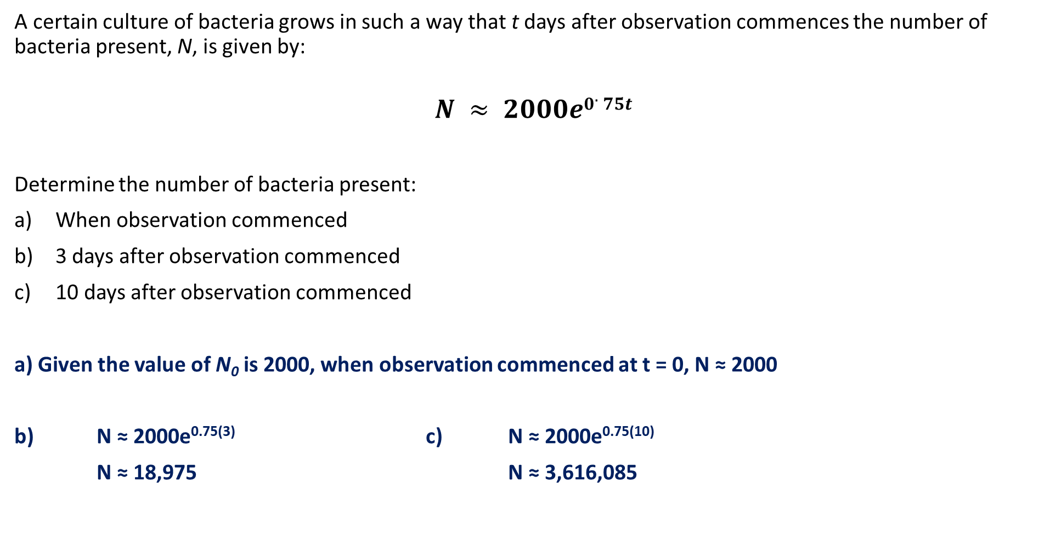
Guided Practice
A certain culture of bacteria grows in such a way that t days after observation commences the number of bacteria present, N, is given by:
$$N ≈ 2000e0.75t$$
Determine the number of bacteria present:
When observation commenced
3 days after observation commenced
10 days after observation commenced
a) Given the value of N₀ is 2000, when observation commenced at t = 0, N ≈ 2000
b) N ≈ 2000e^{0.75(3)} c) N ≈ 2000e^{0.75(10)}
N ≈ 18,975 N ≈ 3,616,085

Slide 12





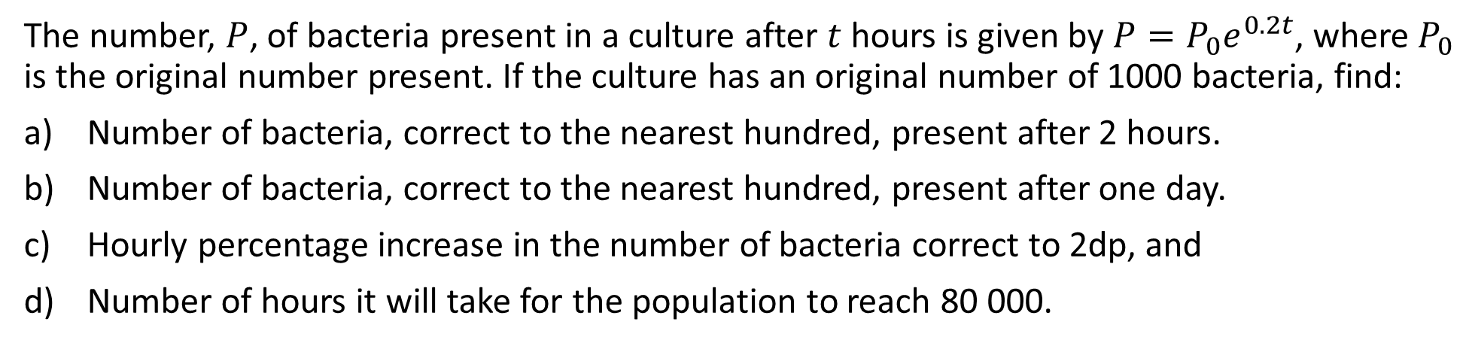








Guided Practice
The number, $P$, of bacteria present in a culture after $t$ hours is given by $P=P_{0}e^{0.2t}$, where $P_{0}$ is the original number present. If the culture has an original number of 1000 bacteria, find:
Number of bacteria, correct to the nearest hundred, present after 2 hours.
Number of bacteria, correct to the nearest hundred, present after one day.
Hourly percentage increase in the number of bacteria correct to 2dp, and
Number of hours it will take for the population to reach 80 000.
a) $t=2, P=1000e^{0.2\left(2\right)}≈1481.82$
c) Consider $t=1, P_{1}=1000e^{0.2}$
Number of bacteria: $1500$
Consider $t=2, P_{2}=1000e^{0.2(2)}$
Percentage of increase: $=\frac{P_{2}−P_{1}}{P_{1}}×100\%$
b) $t=24, P=1000e^{0.2\left(24\right)}≈121 510.42$
Number of bacteria: $121 500$
$=\frac{1000e^{0.2(2)}−1000e^{0.2}}{1000e^{0.2}}×100\%$
d) $P=80000, 80000=1000e^{0.2\left(t\right)}$
$=\frac{1000e^{0.2}(e^{0.2}−1)}{1000e^{0.2}}×100\%$
Use Classpad to solve: $t≈21.91$ hours
$={(e}^{0.2}−1)×100\%$
It would take $22$ hours for population to reach 80000
$≈22.14\%$ per hour

Slide 13













Guided Practice
The population of a town was 8000 at the beginning of 2007 and 15 000 at the end of 2014. Assume that the growth is exponential.
Find the population at the end of 2016, to the nearest tenth
In what year will the population be double that of 2014?
Let $P$ be the population at time $t$ years (measured from 1 January 2007)
$$P=8000e^{kt}$$
Let $t=8$ years, $P=15 000$
b) Let $P=30 000$
$$15000=8000e^{8k}$$
$$30000=8000e^{0.07858t}$$
$$k≈0.07858$$
$t≈16.82$ years
$$P=8000e^{0.07858t}$$
Population will reach 30 000 at end of 2023
At the end of 2016, $t=10$ years
$$P=8000e^{0.07858(10)}$$
$$=17553.29254$$
Population at end of 2016 is $17550$

Slide 14




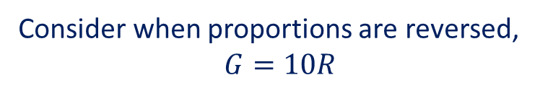



Guided Practice
There are approximately ten times as many red kangaroos as grey kangaroos in a certain area. If the population of grey kangaroos increases at a rate of 11% per annum while that of the red kangaroos decreases at 5% per annum, find how many years must elapse before the proportions are reversed, assuming the same rates continue to apply.
Recall $A=ar^{n}$, where $a$ is the initial value and $r$ is the common ratio
Let $G$ be the population of Grey kangaroos after t years.
$$G=G_{0}{\left(1.11\right)}^{t}$$
Let $R$ be the population of Red kangaroos after t years.
$$R=R_{0}{(0.95)}^{t}$$
$$R=10×G_{0}{(0.95)}^{t}$$
Consider when proportions are reversed,
$$G=10R$$
$$G_{0}{\left(1.11\right)}^{t}=10×10×G_{0}{(0.95)}^{t}$$
$${\left(1.11\right)}^{t}=100{(0.95)}^{t}$$
$x≈29.59$ years
$∴$ the proportions of kangaroo populations will be reversed after 30 years
Notes:
Question does not specify this is exponential.

Slide 15
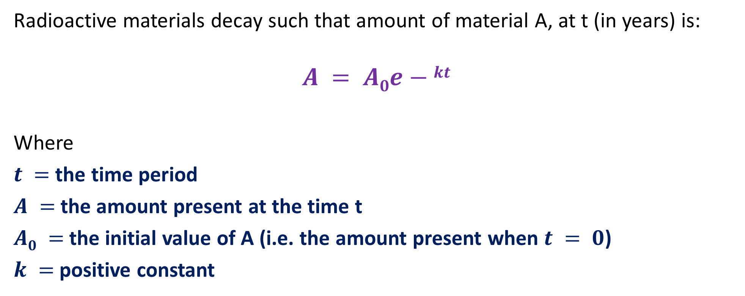
Radioactive Decay
Radioactive materials decay such that amount of material A, at t (in years) is:
$$A = A0e−kt$$
Where
$t =$ the time period
$A =$the amount present at the time t
$A0 =$the initial value of A (i.e. the amount present when $t = 0$)
$k =$positive constant
A radioactive substance is described in terms of half-life.
half-life - Time required fo half the material to decay

Slide 16
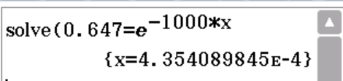












Guided Practice
After 1000 years, a sample of radium-226 has decayed to 64.7% of its original mass. Find the half-life of radium-226.
Using $A=A_{0}e^{−kt}$,
Let $t=1000,$
$$A=0.647A_{0}$$
$$0.647A_{0}=A_{0}e^{−1000k}$$
$$0.647=e^{−1000k}$$
$$k≈0.0004354$$
$∴A=A_{0}e^{−0.0004354t}$
To find half life, $A=0.5A_{0}$
$0.5A_{0}=A_{0}e^{−0.0004354t}$
$0.5=e^{−0.0004354t}$
$t=1592$ years

Slide 17
Independent Practice
Cambridge Ex 2H (use solve in ClassPad instead of log)
All except Q1
Jklup Ex 6B

